Slide 1
The use of text analytics to measure Quality Perception and Patient Understanding of Patient Information Leaflets
Fernando Santos
fss1g15@soton.ac.uk
ECS/FoM
Supervisors:
Prof Jeremy Wyatt, Prof Thanassis Tiropanis

Slide 2
Research objective
The objective is to determine if text analytics techniques currently employed in the analysis of Web text can be used to improve Public reviews of Patient Information Leaflets (PILs) for Randomised Controlled Trials (RCTs).

Slide 3
Research motivation
We want to improve trial recruitment, by:
Improving patient understanding of essential trial features from patient information leaflets (PILs)
Capturing the knowledge generated by PPI groups
Helping Principal Investigators (PIs) identify problems in their PILs

Slide 4
Research findings
We have found the following items during our research:
PILs greatly vary from other common informational text (news articles).
PILs have an skewed emotive spectrum, can have more positive sentiment than most news (Hello Magazine!).
Only comments given to specific sections appear to be significantly associated to the readers understanding or perception of quality
To determine the PIL capacity to inform essential features of the trial is necessary to observe more aspects than just general comments or subjective quality grades.

Slide 5
Research aims
Our next study aims to:
Quantify the effect adding structured reports based on Web analytic techniques to the PPI feedback on PILs has on the final readability of the PIL.
Content analysis
Sentiment analysis
Quantitative metrics report
Knowledge database

Slide 6
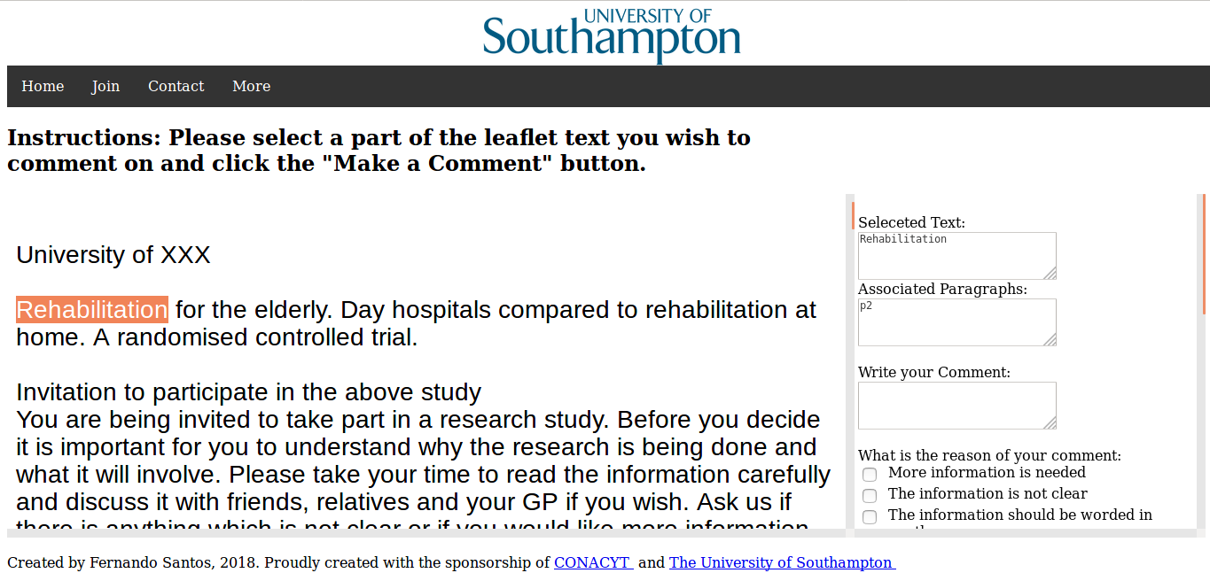
Web platform

Slide 7
Conclusions
Only 42% of participants gave comments about specific sections of the leaflets
There was no significant association between the number of general comments and the subjective quality grades or the percentage of correct answers (EQIP score).
The leaflet’s capacity to inform participants cannot be determined by purely taking into account general comments or subjective quality grade – use specific comments and EQIP score
Fernando Santos Sanchez, fss1g15@soton.ac.uk

